Slide 1




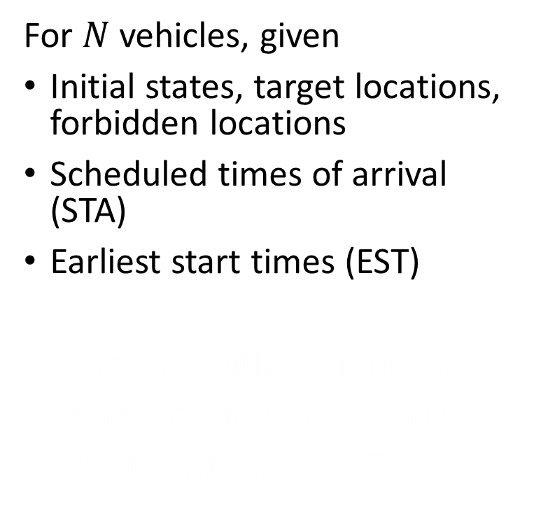
Sequential Path Planning
For $N$ vehicles, given
Initial states, target locations, forbidden locations
Scheduled times of arrival (STA)
Earliest start times (EST)
Determine, with guarantees
Minimum-time trajectories
Latest start times (LST)
Forbidden
Targets
Vehicle
Danger zone

Slide 2
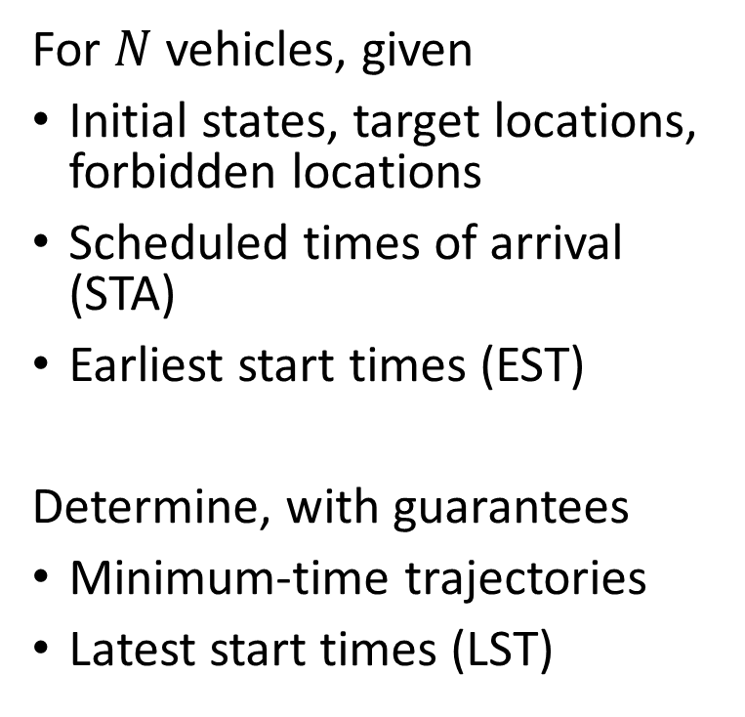
Sequential Path Planning
For $N$ vehicles, given
Initial states, target locations, forbidden locations
Scheduled times of arrival (STA)
Earliest start times (EST)
Determine, with guarantees
Minimum-time trajectories
Latest start times (LST)
Forbidden
Targets
Vehicle
Danger zone

Slide 3
Approximate Solution
Joint optimal solution is intractable
Sequential path planning
Assign vehicle priorities
Treat higher-priority vehicles as moving obstacles
Forbidden
Targets
Vehicle
Danger zone

Slide 4
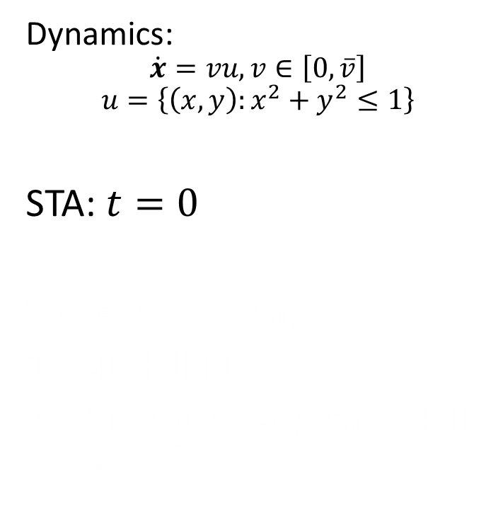
Two-Vehicle Example
Dynamics:
$$\dot{x}=vu,v∈\left[0,\overline{v}\right]$$
$$u=\left\{\left(x,y\right):x^{2}+y^{2}≤1\right\}$$
STA: $t=0$
Solve in two ways
4D HJI PDE
2D double-obstacle HJI VI $×2$

Slide 5
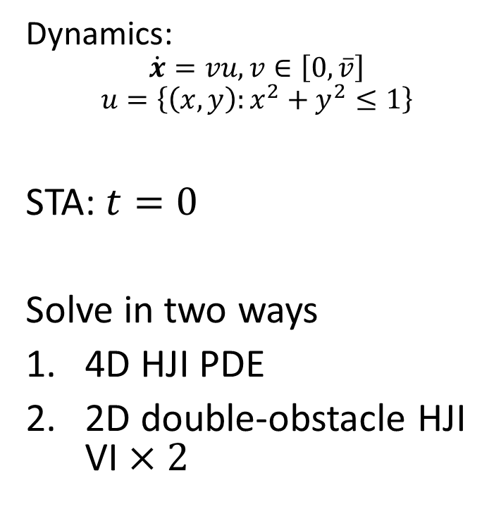
Two-Vehicle Example
Dynamics:
$$\dot{x}=vu,v∈\left[0,\overline{v}\right]$$
$$u=\left\{\left(x,y\right):x^{2}+y^{2}≤1\right\}$$
STA: $t=0$
Solve in two ways
4D HJI PDE
2D double-obstacle HJI VI $×2$

Slide 6
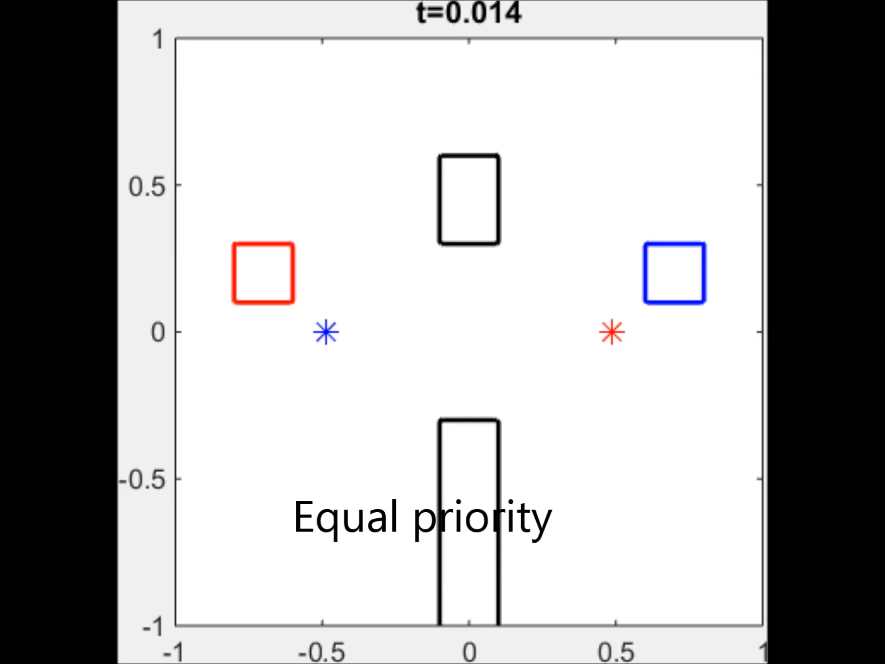
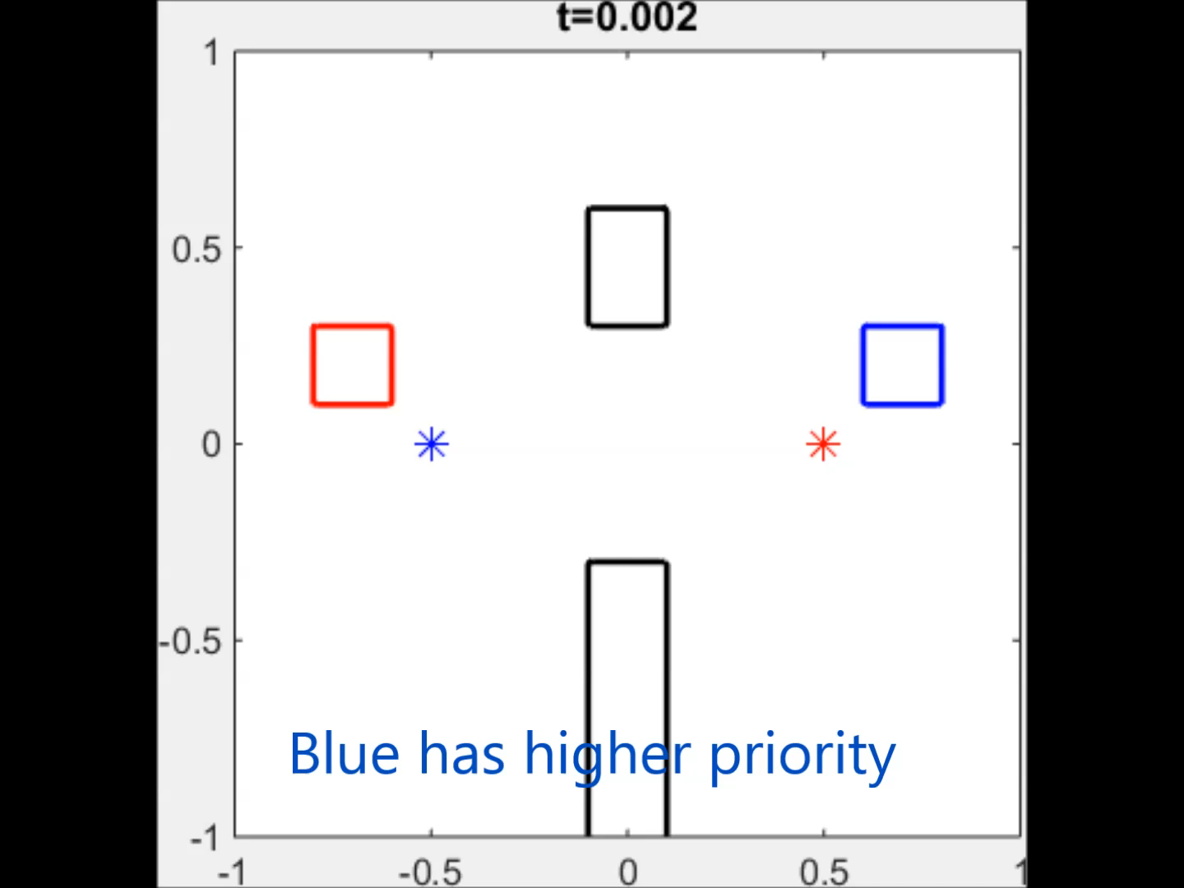

Results
Equal priority: Latest arrival at $t=1.15$
Prioritize blue: Latest arrival at $t=1.12$
Prioritization does not introduce much suboptimality
Equal priority computation is less accurate

Slide 7
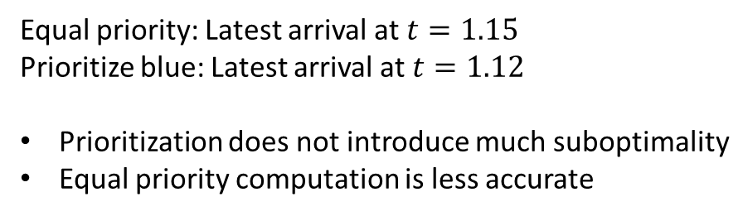
Results
Equal priority: Latest arrival at $t=1.15$
Prioritize blue: Latest arrival at $t=1.12$
Prioritization does not introduce much suboptimality
Equal priority computation is less accurate

Slide 8
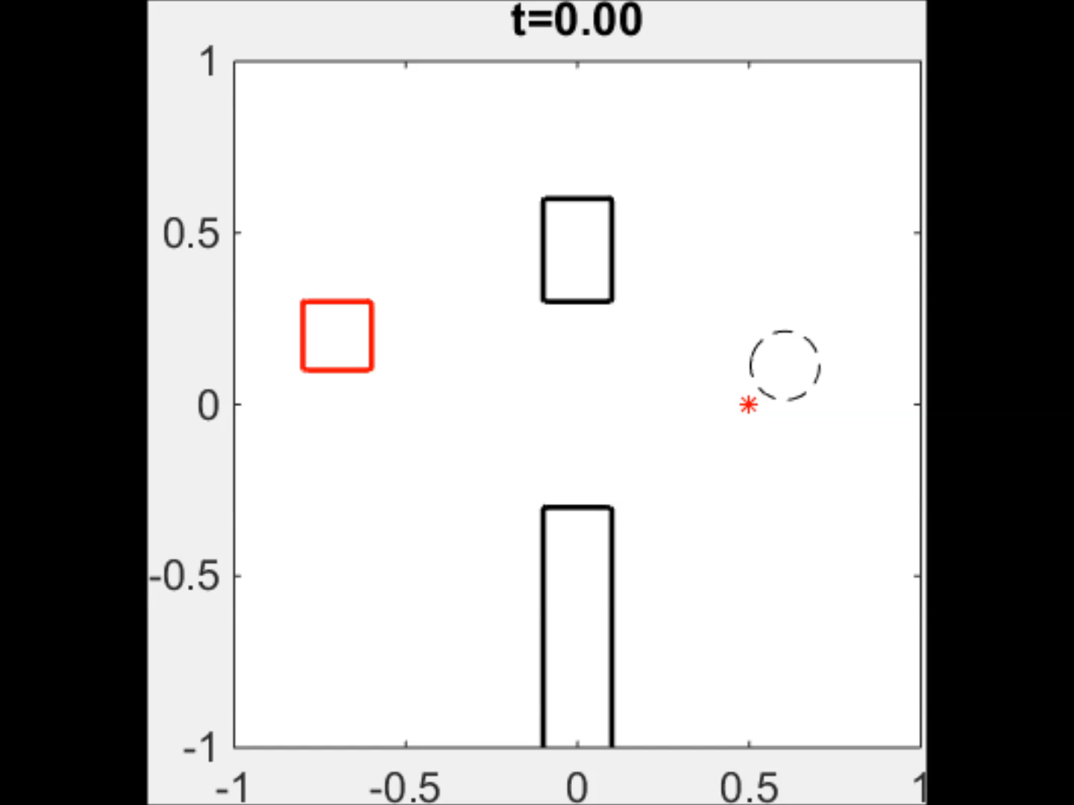
Reach-Avoid Set Time Evolution

Slide 9
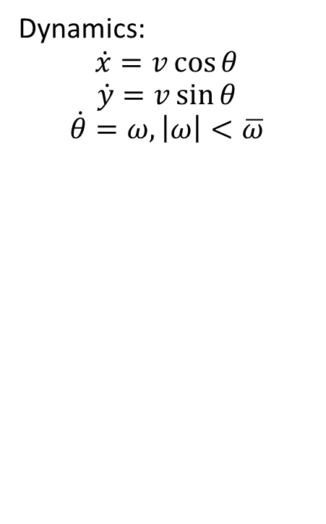
Four-Vehicle Example
Dynamics:
$$\dot{x}=v\cos{θ}$$
$$\dot{y}=v\sin{θ}$$
$$\dot{θ}=ω,\left|ω\right|<\overline{ω}$$
STAs

Slide 10
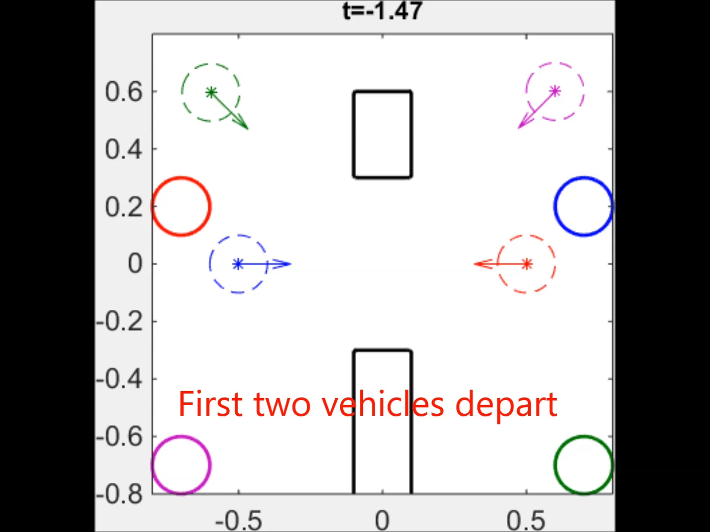
Trajectories

Slide 11
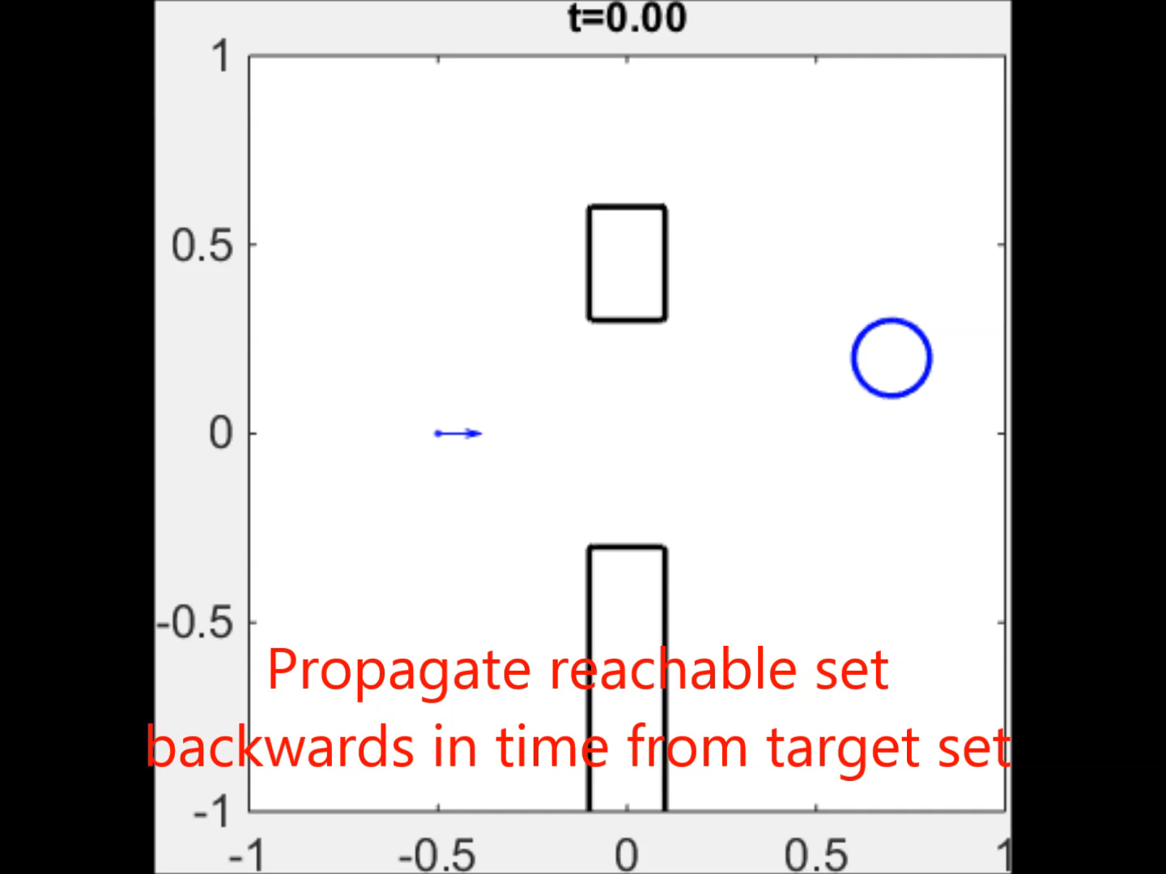
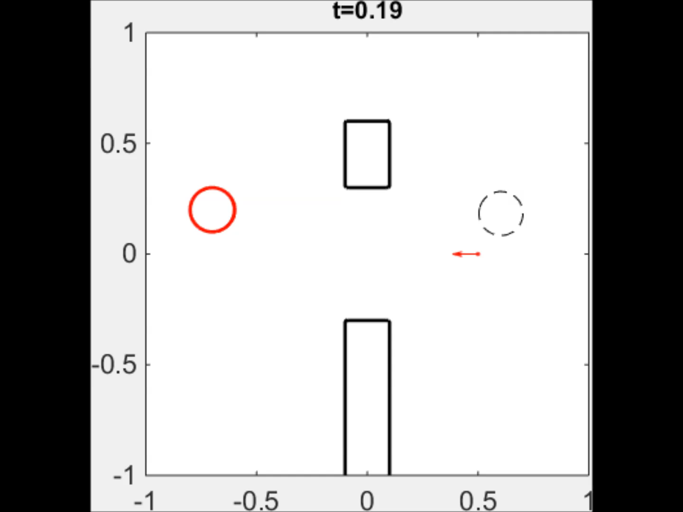
Reach-Avoid Set Time Evolution

Slide 12
Reach-Avoid Set Time Evolution
STAs and LSTs

Slide 13
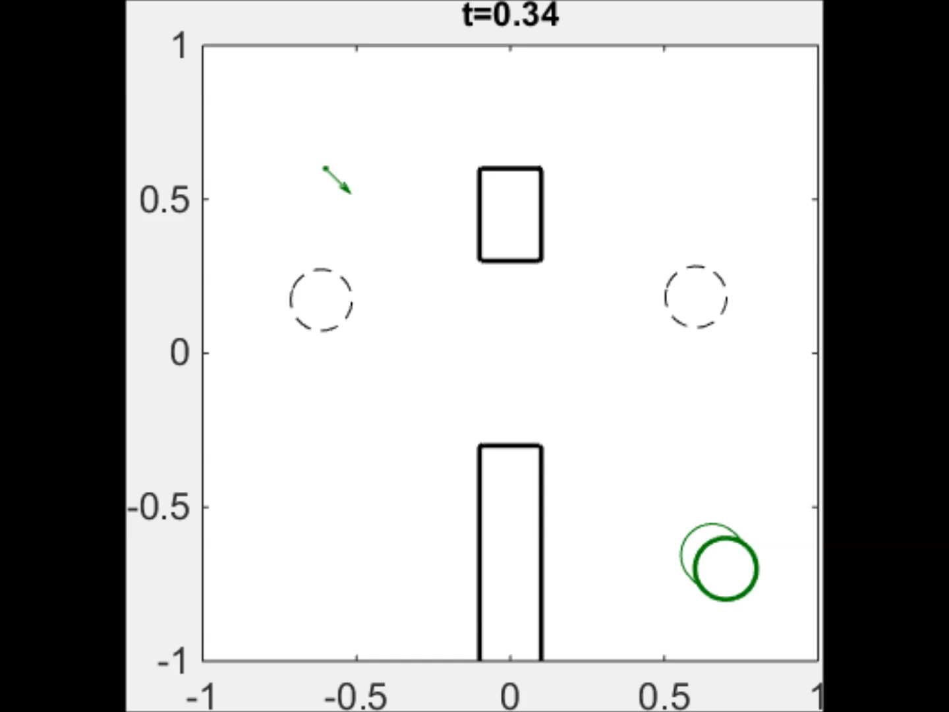
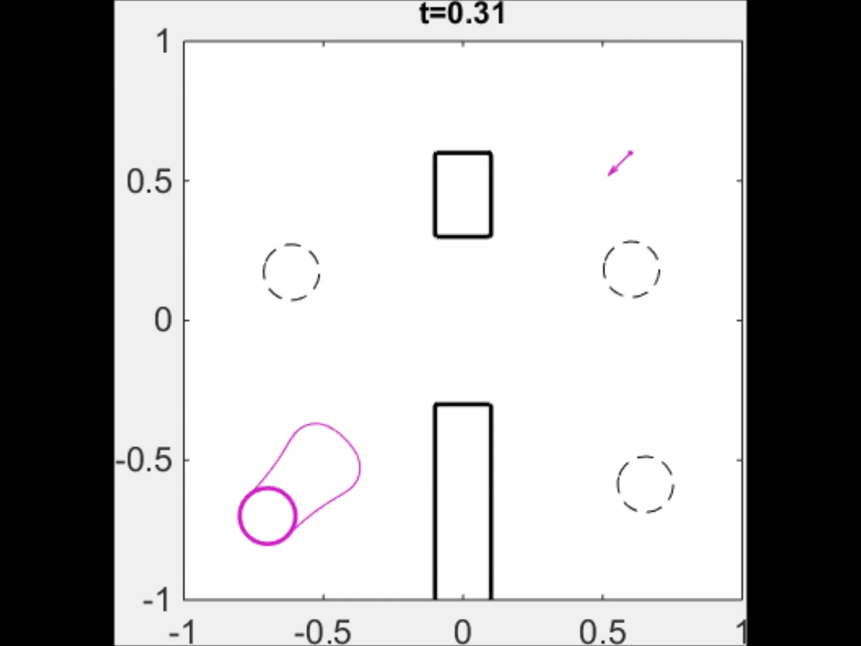
Reach-Avoid Set Time Evolution
STAs and LSTs

Slide 14
Future Work
Uncertainty in planned trajectories
More realistic dynamics
Sophisticated induced obstacles
Groups of vehicles in formation

